Slide 1
Boolean Logic
Imam Yuadi

Slide 2
What it is?
Boolean Logic is Algebra that works with logical rather than numeric relationships.
Boolean algebra was introduced in 1854 by George Boole
Boole devised a mathematical language to deal with questions of logic.
Boole is now considered the father of modern information technology
Source: https://masters.libguides.com/booleanlogic

Slide 3


Cont’
Algebra comes from the Arabic al-jebr meaning "reunion of broken parts" (jebr can be pronounced either gobre or jobre)
Algebra uses letter to represent unknown number
In Algebra variables like x and y = numerical values
for example x + 4 = 8
Boolean Logic is a form of algebra in which the variables have a logical value of TRUE or FALSE.
In Boolean algebra x and y = classes of objects
for example x = triangles and y = circles
Source: https://masters.libguides.com/booleanlogic

Slide 4
Boolean Operators
AND = Can be thought of as BOTH. It requires that both or all objects (search terms) be present in the results. In online searching AND serves to narrow the search and is used for combining differing concepts.
OR = Can be thought of as EITHER. It is used to find either one term or another. In online searching OR serves to broaden a search and is used to search synonymous or closely related terms.
NOT = Can be thought of as AND NOT. It is used to eliminate records. In online searching it serves to narrow a search. Exercise caution when using the Boolean NOT as needed concepts may be eliminated unintentionally.
Source: https://masters.libguides.com/booleanlogic

Slide 5
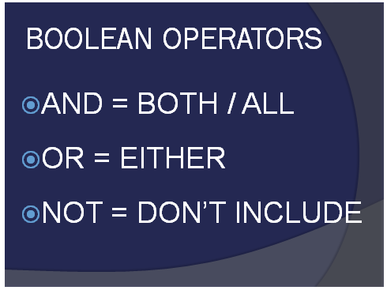
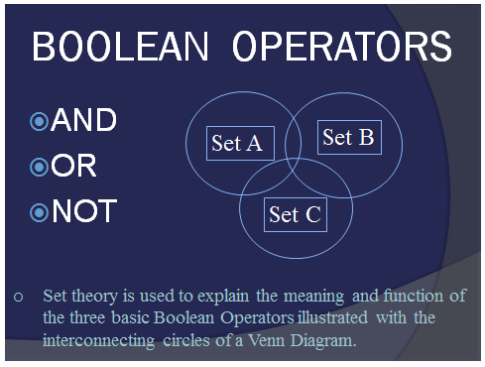
Boolean Operator

Slide 6
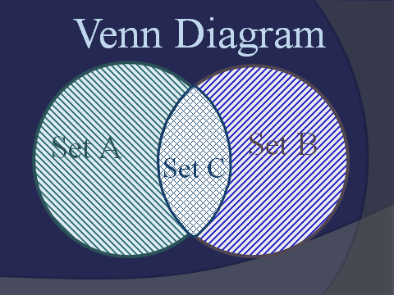
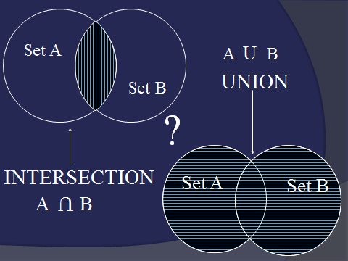
Venn Diagram Set Theory

Slide 7
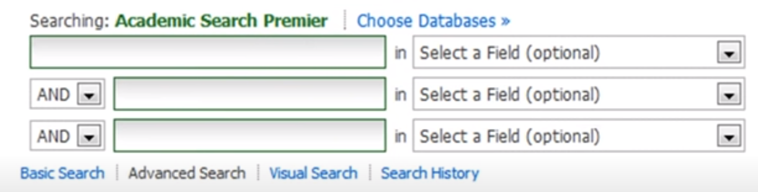
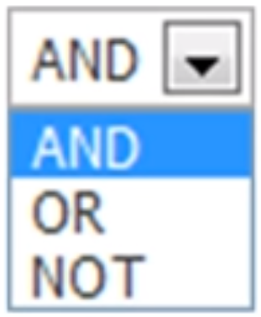
Boolean used at Online Searching

Slide 8
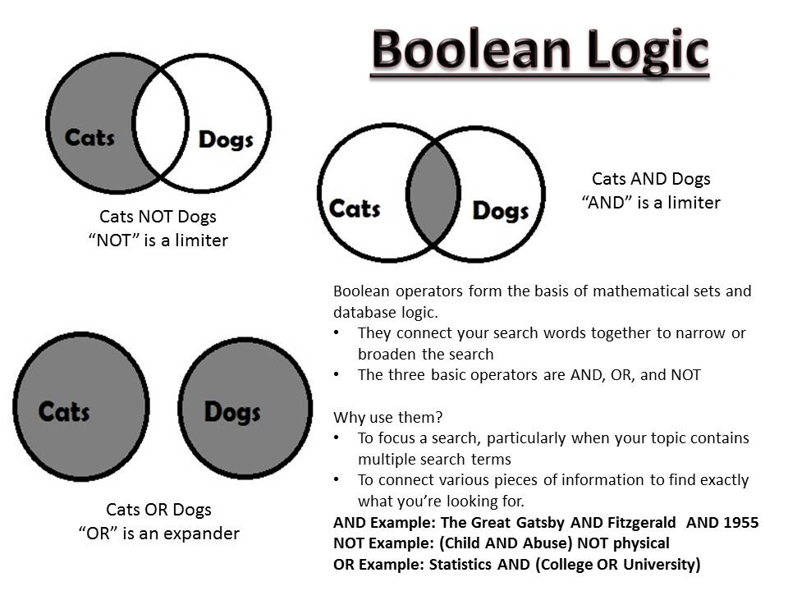

Slide 9
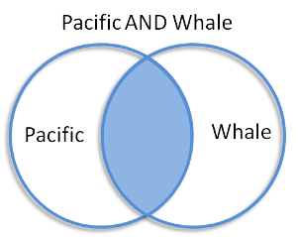
Example AND
Yang ditampilkan hanya ikan paus yang ada di pasifik
AND is used to narrow down your search. When you add AND between two or more search terms, your search results will include all of your search terms.
The blue area in the illustration to the right represents the results that would be returned for the search Pacific AND Whale. All the articles will have both terms.
Lets take a closer look.
In the database, Web of Science, the searches for Pacific, Whale, and Pacific AND Whale break down like this:
Pacific = 169,593 results Whale = 17,686 results Pacific AND Whale =1,945 results
Source: https://guides.library.manoa.hawaii.edu/c.php?g=105358&p=683949

Slide 10
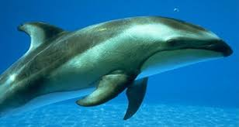
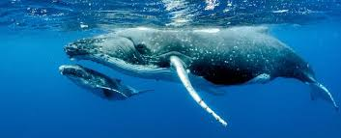
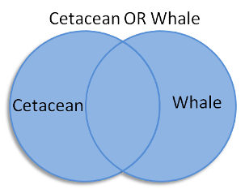
Example OR mencari sesuatu yang lebih luas
OR is used to broaden your search. When you add OR between two or more search terms, your search results will include either of your search terms.
The blue area in the illustration to the right represents the results that would be returned for the search Cetacean OR Whale. All the articles will have both terms.
Lets take a closer look.
In the database, Web of Science, the searches for Cetacean, Whale, and Cetacean OR Whale break down like this:
Cetacean = 5,945 results Whale = 17,686 results Cetacean OR Whale = 20,532 results
Source: https://guides.library.manoa.hawaii.edu/c.php?g=105358&p=683949

Slide 11
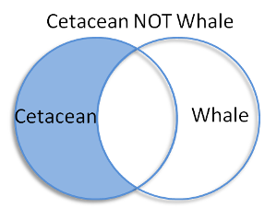
Example
NOT is used to narrow your search. When you add NOT between two or more search terms, your search results will include only the term before the NOT.
The blue area in the illustration to the right represents the results that would be returned for the search Cetacean NOT Whale. All the articles will have only one of the terms - Cetacean.
Lets take a closer look.
In the database, Web of Science, the searches for Cetacean, Whale, and Cetacean NOT Whale break down like this:
Cetacean = 5,945 results Whale = 17,686 results Cetacean NOT Whale = 2,846 results
Source: https://guides.library.manoa.hawaii.edu/c.php?g=105358&p=683949

Slide 12
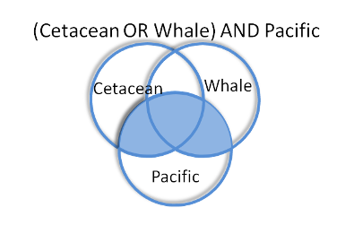
Para thesis,menggunakan dua logika
Menggunakan or baru menggunakan and
The blue area in the first illustration represents the results that would be returned for the search (Cetacean OR Whale) AND Pacific, which yields 633 results and gives us articles with the following combinations:
Cetacean, Pacific Whale, Pacific Cetacean, Whale, Pacific
Note that Cetacean and Whale may or may not be present, but Pacific will appear in every search result. This is because Cetacean and Whale are linked with OR while Pacific is added to the search with AND.
https://guides.library.manoa.hawaii.edu/

Slide 13
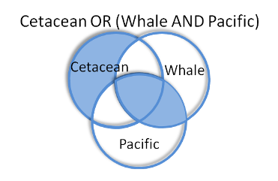
Boolean Logic
The blue area in the second illustration represents the results that would be returned for the search Cetacean OR (Whale AND Pacific), which yields 1718 results and gives us articles with the following combinations:
Whale, Pacific Whale, Pacific, Cetacean Cetacean
Note that Whale and Pacific must always appear together, or not at all, while Cetacean may be the only term present. This is because Whale and Pacific are linked with AND and Cetacean is added to the search with OR.
https://guides.library.manoa.hawaii.edu/
Notes:
Boo - lee - in

Slide 14
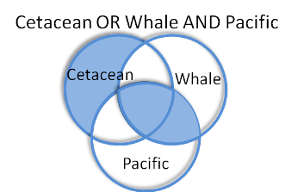
Using Parentheses(paranthesis sebaiknya igunakan didepan,jika paranthesis ditaruh dibelakang hasilnya sama saja dengan tidak menggunakan paranthesis
When the same search is run with no parentheses - Cetacean OR Whale AND Pacific - we get the same search results as Cetacean OR (Whale AND Pacific). This is because of search precedence which is discussed to the right.
https://guides.library.manoa.hawaii.edu/

Slide 15
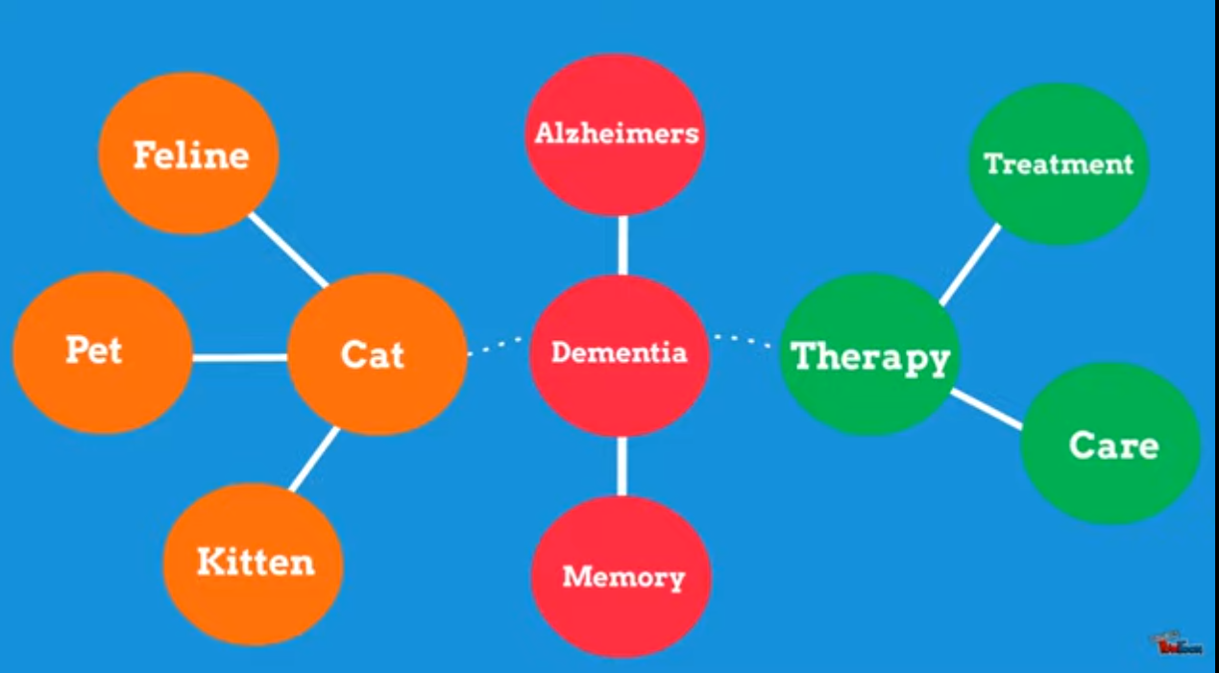
Keyword for Boolean Combination

Slide 16


Slide 17
Truncation help by broadening your keyword search by attaching to the root of a word, this is usually done by adding an asterisk to the end of the root of a word. For example: Child* = children, children’s, child’s, childhood
Special Character that can be appended to the root of a word so you can search for all possible endings to that root
Good for variant spellings and common root words
Example
rocket* will yield rocket, rockets, rocketry
psycholog* = psychology, psychological, psychologist
colo*r = color and colour

Slide 18
Wildcards are useful when multiple spellings of a word can affect your search. Remember, the symbol of the wildcard may change depending on which database you use. For example: coloni?e = colonise, colonize
Wom!n = woman, women

Slide 19
more examples
(children OR kids) AND nutrition Notice that the OR links two synonyms
(elderly OR "older adults") AND (computers OR technology) You can use two or more sets of parentheses
((teenager OR teen OR adolescent) AND media) NOT television You can also use parentheses within parentheses.

